Slide 1


Slide 2
Pragati Jain
Learn to Visualize using DAX Tricks in Power BI

Slide 3











Speaker: Pragati Jain
Microsoft Data Platform MVP
Superuser at Microsoft Power BI Community
10+ years of industry experience
Manager at Avanade, London
Organizer at DataWeekender conference
Manager at Microsoft Power BI UK User Group
Fun Fact About Me:
I am a painter and proudly call myself ‘TechieArtist’ 😊

Slide 4
AGENDA
In today’s session, I will be talking about few of my favourite DAX tricks in Power BI that can help to overcome visualisation limitations.
Dynamic Data points on Line chart Above & Below Average value
Highlight MAX – MIN value on clustered column chart
Display Top N selected bars in the chart
Dynamic Bar Colors for Current & Previous Year same Quarter
Conditional Titles on visuals based on slicer selection
Dynamic color to Card Visual based on slicer selection

Slide 5
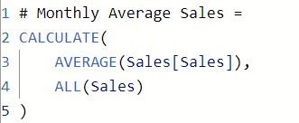
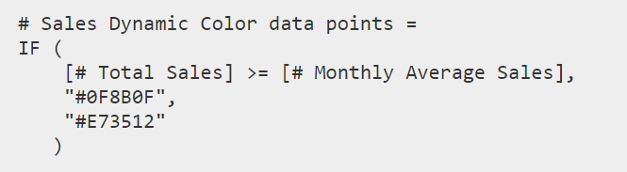
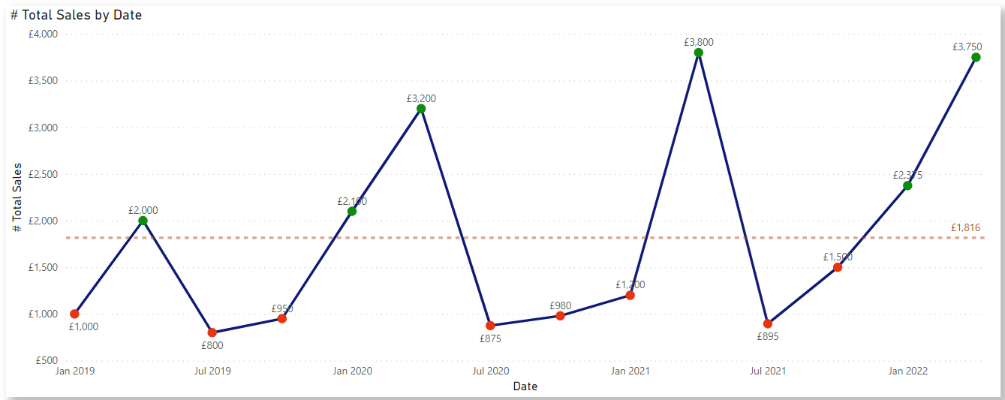
Use case 1
Dynamic Data points on Line chart Above & Below Average value
AVERAGE function returns the average of all numbers from Sales column
ALL calculates a calculation on all the rows of sales column ignoring any filters.
IF statement compares total sales with monthly average sales
A colour code is given based on conditional comparison

Slide 6
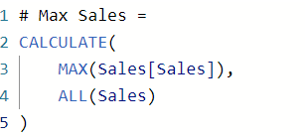
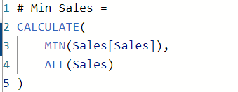
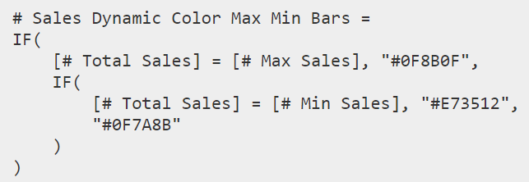
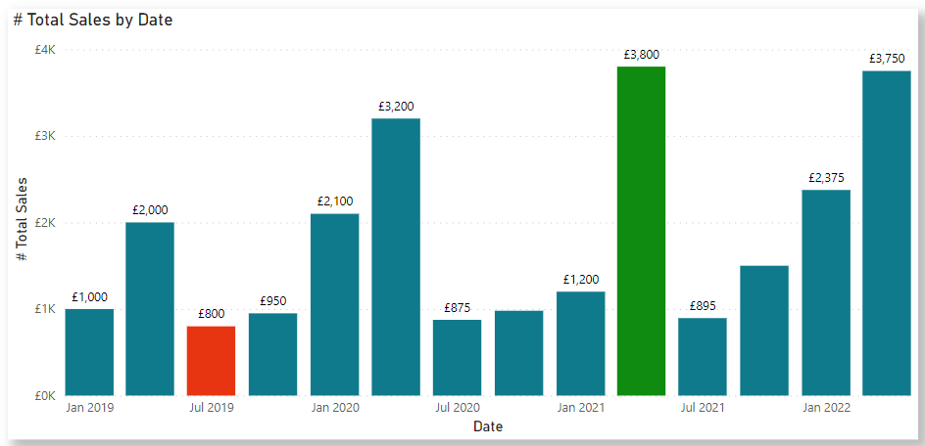
Use case 2
Highlight Max Min value on Bar Chart
Maximum sales value from Sales column.
ALL calculates a calculation on all the rows of sales column ignoring any filters.
Minimum sales value from Sales column.
ALL calculates a calculation on all the rows of sales column ignoring any filters.
A colour code is given based on conditional comparison

Slide 7
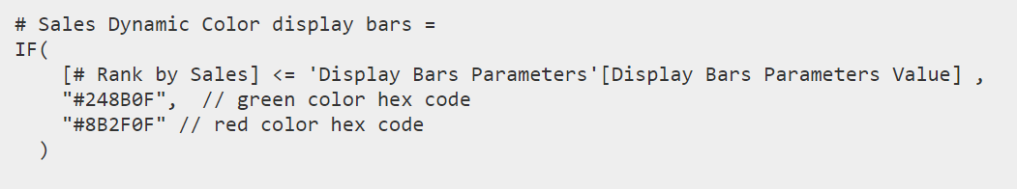
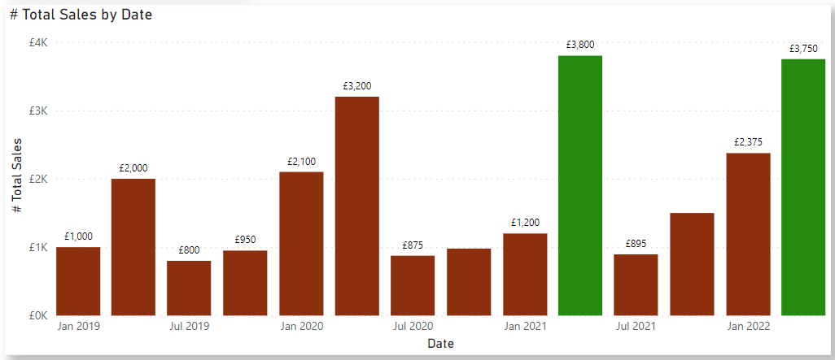
Use case 3
Display Top N Selected Bars in a Visual
RANKX returns a ranking based on sales value.
A colour code is given based on conditional comparison.
If my Rank value is <= value selected in the parameter, all the bars with rank <= get a GREEN colour.

Slide 8
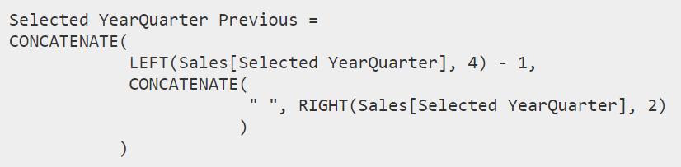
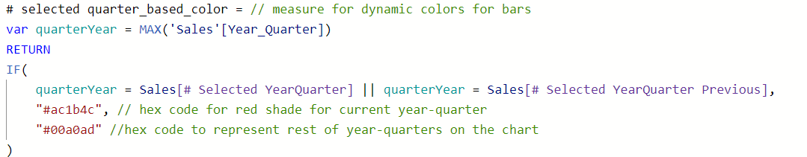
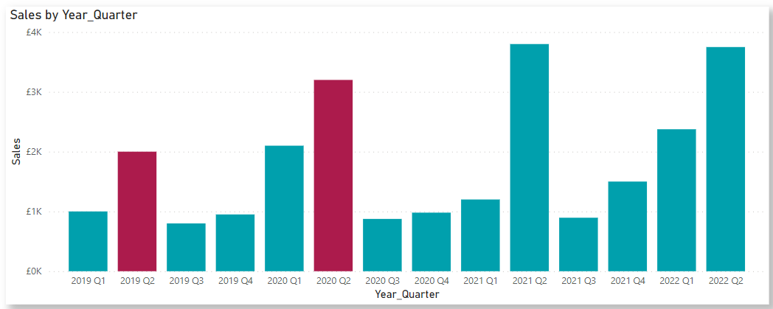
Use case 4
Dynamic Bar colours for Current & Previous Year SAME QUARTER
Getting selected value of Year-Quarter from slicer
LEFT extracts the number of characters from a string from left. In this case we extract the YEAR part from year-quarter column and subtract 1 to get previous year value. RIGHT extracts no. of characters from a string from right.
CONCATENATE further concatenates previous year and quarter value to a single string.
A colour code is given based on conditional comparison

Slide 9
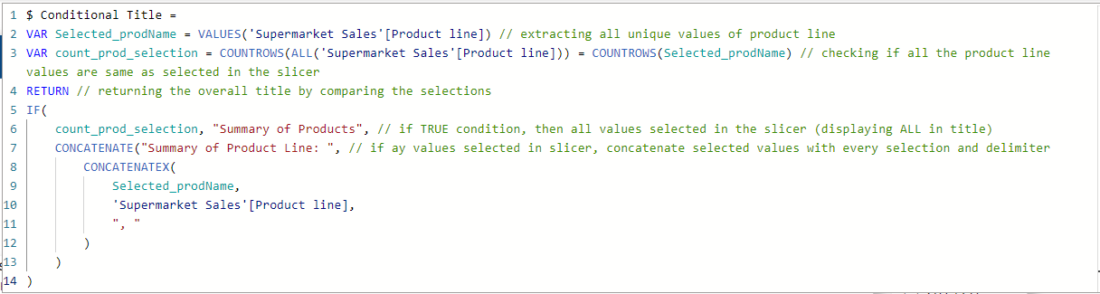
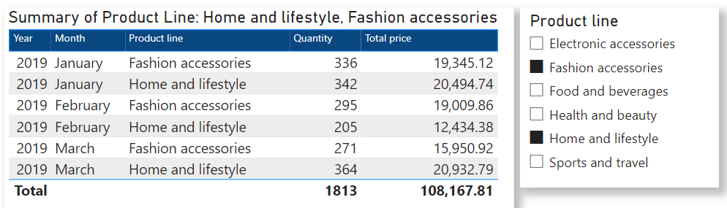
Use case 5
Conditional Titles on visuals based on User Selection

Slide 10
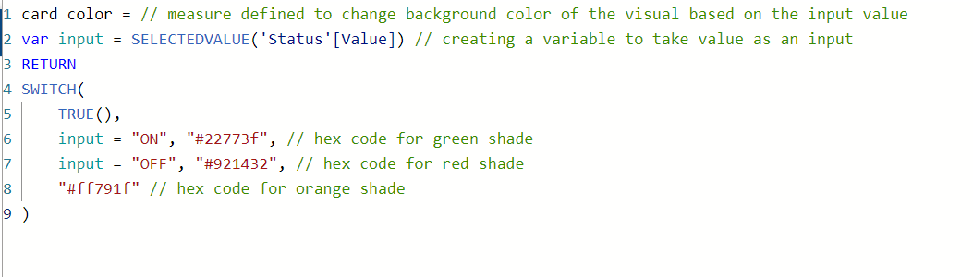
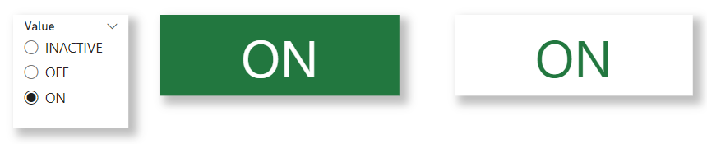
Use case 6
Dynamic colour to Card visual based on slicer selection
A colour code is given based on conditional comparison

Slide 11
Resources to study more
Power BI Community
SQLBI Blog
Perytus YouTube channel

Slide 12

Thank You and Happy to answer any questions!
Dziękuję

